Slide 1



The 5th International MCX Training Workshop
Qianqian Fang, PhD
Associate Professor
Dept. of Bioengineering
Northeastern University, USA
MCX’24, Northeastern University
MCX website: https://mcx.space

Slide 2
Outline
Group introduction
The MCX project
MC algorithm workflow highlights
Knowing the limits
Hardware recommendations

Slide 3
Group Introduction
Session 1.A
MCX’24
MCX website: https://mcx.space

Slide 4
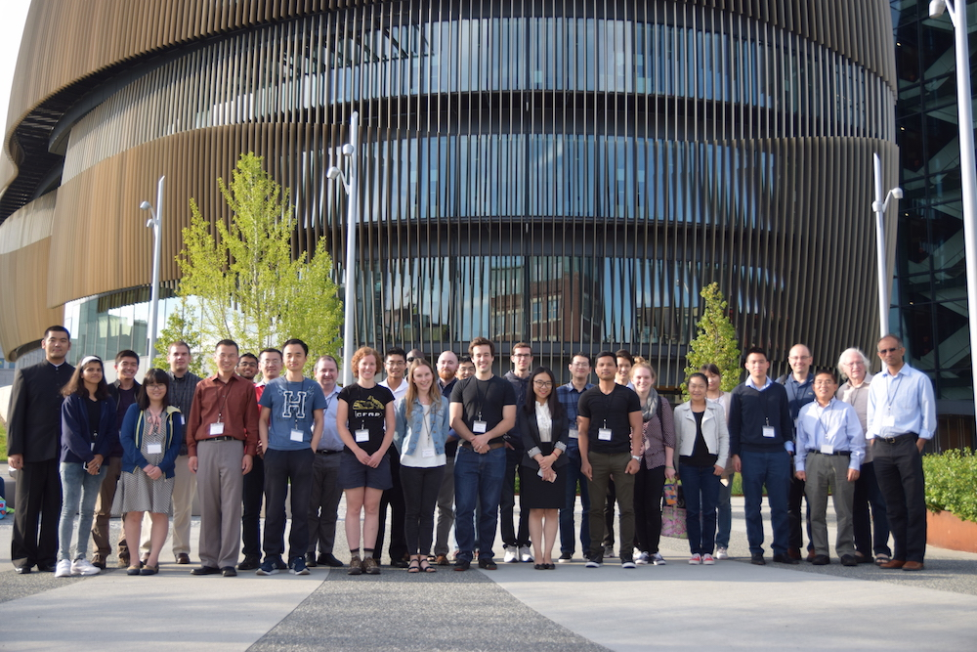
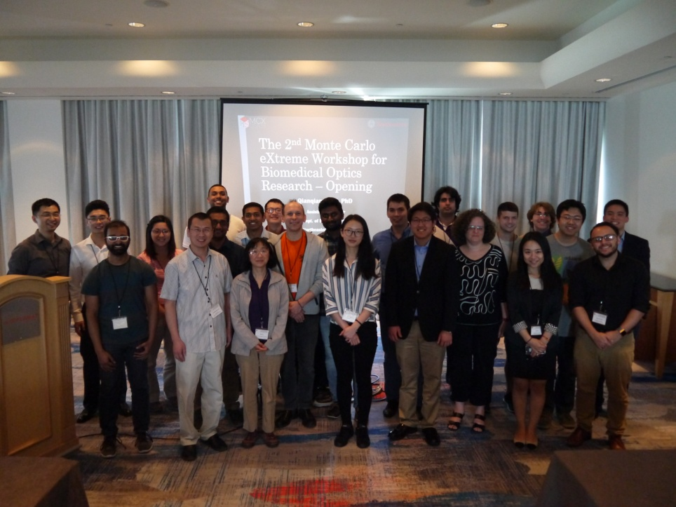
MCX Training workshops
2017, 2019 at Northeastern Boston Campus
2018 at Hollywood, FL, OSA Biomedical Imaging
2022 at Boston fNIRS mini-course

Slide 5

The MCX Project
Session 1.B
MCX’24
MCX website: https://mcx.space

Slide 6






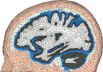




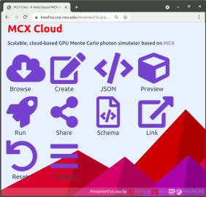

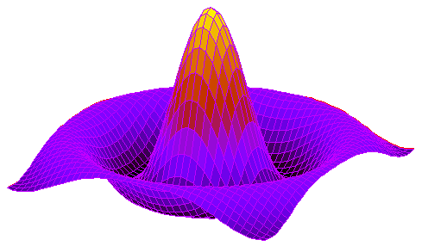


MCX Suite – full-stack solution
MMC
(Trinity)
Brain2mesh
MCX
MCX-CL
MMC-SSE/CL/CUDA
Iso2Mesh
MCXLAB/CL
MMCLAB
Mex files
pmcx
MATLAB
GNU Octave
Standalone
GUI
MCX Cloud

Slide 7
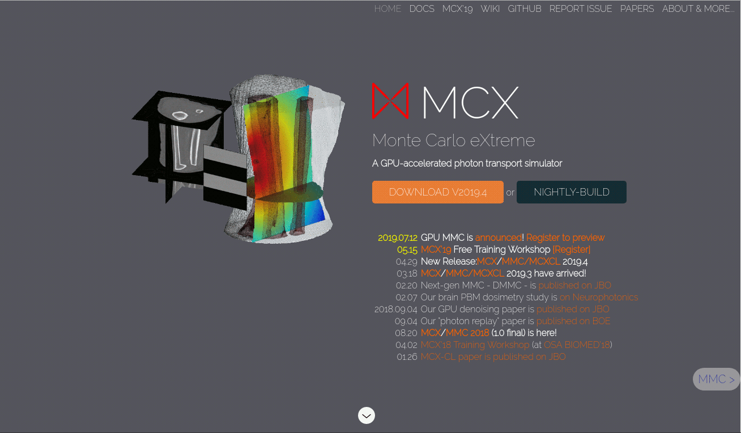
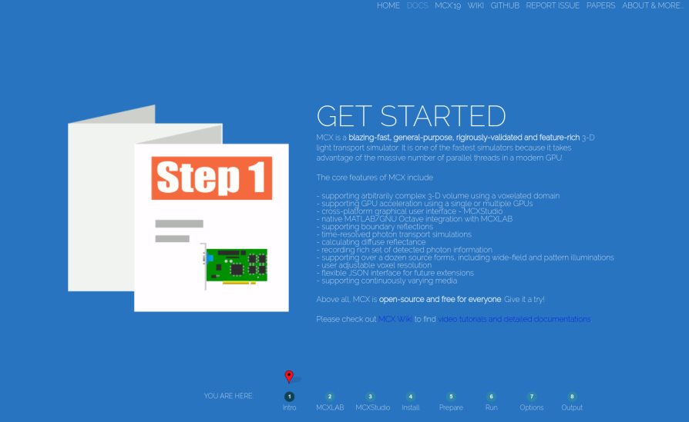
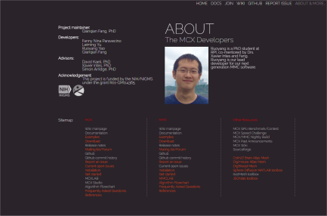
Online resources
https://mcx.space
https://mcx.space/wiki/
https://mcx.space/cloud/

Slide 8
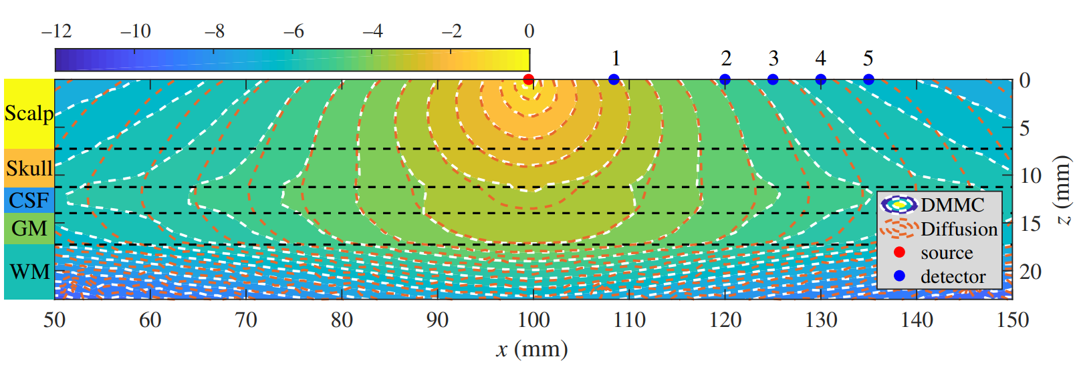
Where MCX/MMC excel?
Speed
Accuracy
Tran AP+, Yan S+, Fang Q*, (2020) “Improving model-based fNIRS analysis using mesh-based anatomical and light-transport models," Neurophotonics, 7(1), 015008

Slide 9
Acknowledgement
This project is funded by the NIH/NIGMS under the grant R01-GM114365 (MCX, https://mcx.space)
NIH/NINDS under grant U24-NS124027 (https://neurojson.org).
NIH/NCI under grant 2R01-CA204443.

Slide 10
MCX Algorithm Highlights
Session 1.C
MCX’24
MCX website: https://mcx.space

Slide 11
MCX/MMC Algorithm Diagram
Start
Launch (p, v, w)
Determine unitless
scattering len. S
Calculate the distance D to cell boundary, define d=min(D, S/µ_{s})
Move photon by d: p= p+d*c
S=S-d*µ_{s}
Update packet weight Δw=w*[1-exp(-µ_{a}d)]
w=w-Δw
Accumulate Δw to the cell enclosing the path
Determine new
Scattering dir: v
n
y
y
Time limit exceeds?
Arrive at a scattering site (S≤0)?
n
n
Cross a boundary & n1≠n2?
y
n
y
Do Reflection?
y
Reflect
n
N photon?
Exit domain?
n
y
Transmit
End

Slide 12
Complex Source Types
v0
p0
Point sources:
Pencil beam, isotropic source, cone beam
Line sources:
Isotropic line source, slit source
Area sources:
Planar, disk, Fourier domain source, Gaussian source, arbitrary 2D pattern source (load a 2D array)
All area/line sources support convergent and divergent beams (cfg.srcdir=[vx, vy, vz, focal_length])
p0
v0
focal_length
(negative)

Slide 13
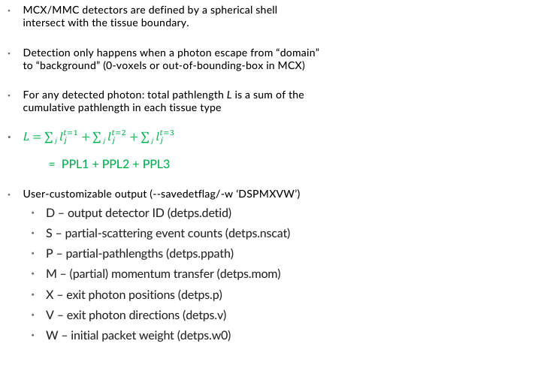
Photon detection and partial path lengths
src
det
MCX/MMC detectors are defined by a spherical shell intersect with the tissue boundary.
Detection only happens when a photon escape from “domain” to “background” (0-voxels or out-of-bounding-box in MCX)
For any detected photon: total pathlength L is a sum of the cumulative pathlength in each tissue type
$L=\sum{j l_{j}^{t=1}}+\sum{j l_{j}^{t=2}}+\sum{j l_{j}^{t=3}}$
= PPL1 + PPL2 + PPL3
User-customizable output (--savedetflag/-w ‘DSPMXVW’)
D – output detector ID (detps.detid)
S – partial-scattering event counts (detps.nscat)
P – partial-pathlengths (detps.ppath)
M – (partial) momentum transfer (detps.mom)
X – exit photon positions (detps.p)
V – exit photon directions (detps.v)
W – initial packet weight (detps.w0)
tissue#3
tissue#2
tissue#1

Slide 14
Knowing the limits
Session 1.D
MCX’24
MCX website: http://mcx.space

Slide 15
Knowing the limits is the key
Avoid brute-force
MC is slow in large voxel/mesh size, excessive time gates, large photon number - start with less demanding settings, move up only when results is not stable
Give MCX resources is the key to speed
The more GPU cores, the faster speed. Giving MCX better hardware, it can scale linearly
Domain discretization matters
Voxelated domain does not work well in transparent/low-scattering medium
Unjustified optical properties negate your accuracy gain
A simulation is only as good as the chosen settings
Complexity is not always good
You can make your simulation as realistic as possible, but at some point, increase in complexity yields diminished gain, know where to stop

Slide 16
Hardware Recommendations
Session 1.E
MCX’22
MCX website: http://mcx.space

Slide 17


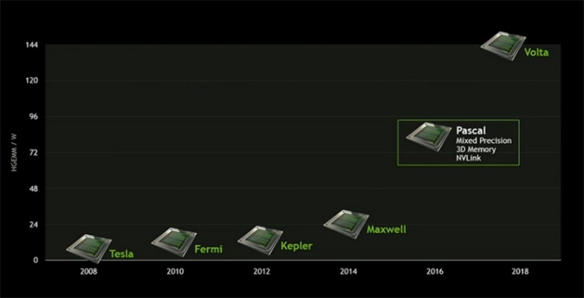

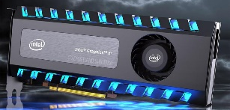
Recommended Hardware
The more cores, the merrier! Use many consumer-grade cards together!
MCX (CUDA) is NVIDIA GPU only; MCXCL/MMCL can run on (almost) all processors. But CUDA is faster than OpenCL.
MCX uses single-precision floating-point operations, Tesla cards (more expensive) are not necessarily faster.
Dedicated GPU preferred – i.e. not used for display. Multiple-cards can gain speed almost linearly.
MCX
MCX-CL
MMC
Fiji, Polaris,Vega,
Navi

Slide 18
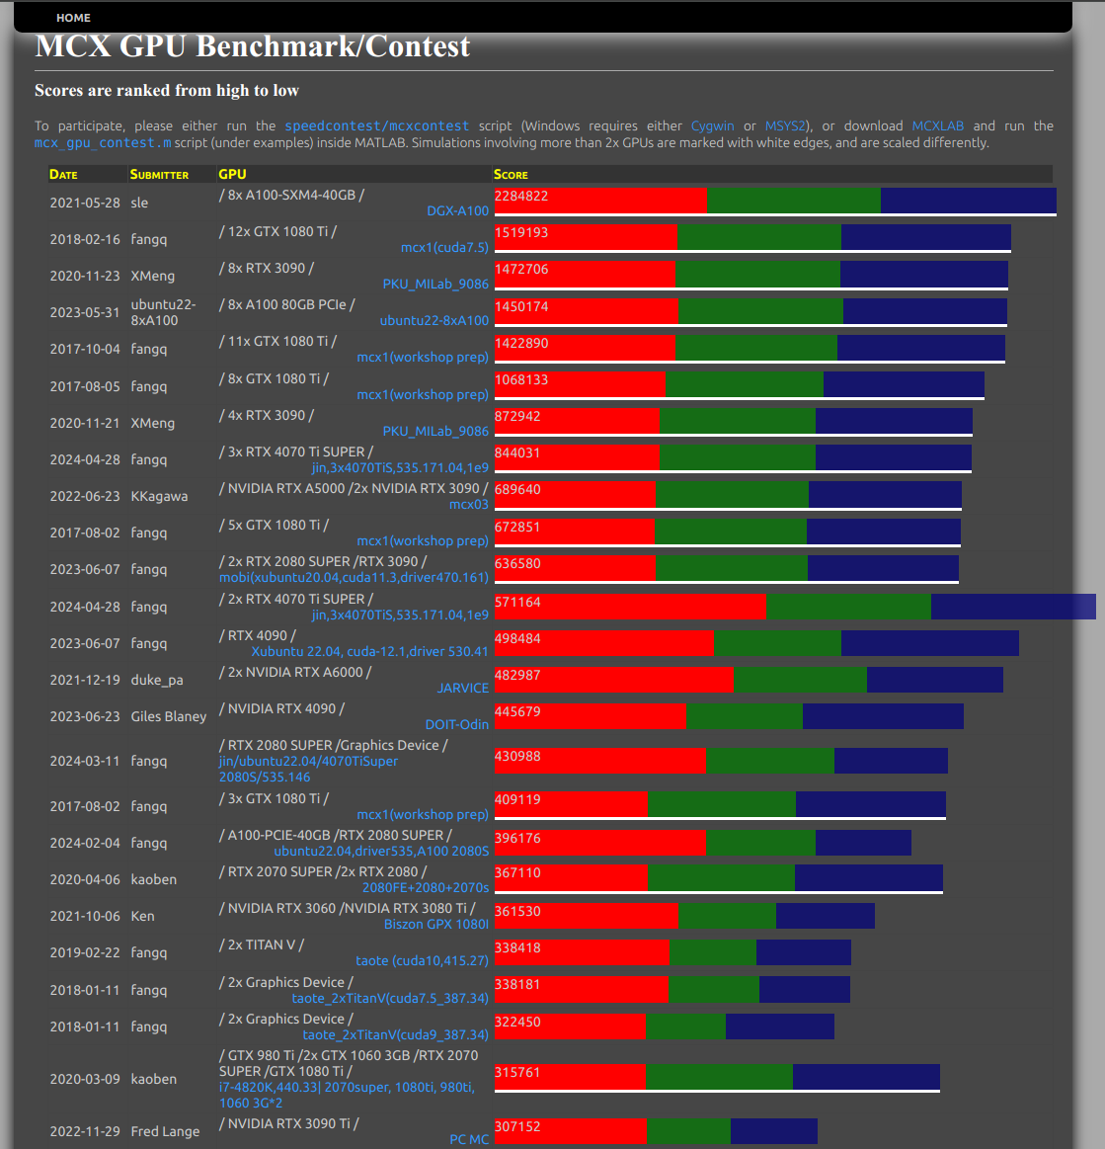
GPU Benchmarks/Contest
http://mcx.space/gpubench

Slide 19
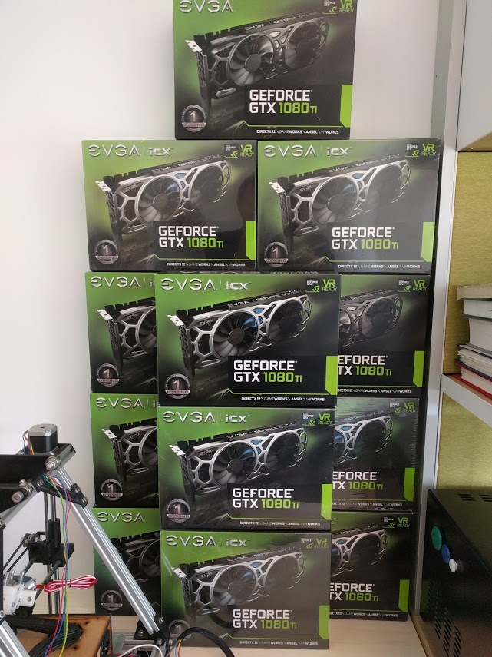
MCX1

